Slide 1
Scientific programming with C++
Input and output, variables, functions, parameters

Slide 2
Learning objectives
After this lecture and related assignments, you will…
know how to use variables in common cases
convert them to other variables
and the implications of using different data types
have basic knowledge of what functions are
the difference between passing by value and passing by reference
and the difference between parameter and argument
be introduced to declarations, definitions and initializations
know how to read input from the user
know how to print output to the user

Slide 3
Input and output basics
Input: data flows from device (keyboard) to memory
Output: data flows from memory to device (computer screen)
Main headers
iostream
For reading keyboard input and outputting to command window
fstream
For reading files and writing files
This topic will focus on iostream

Slide 4
Output: cout
The basic building block of printing to screen: cout
Part of iostream header, std namespace
Continues from where the previous stream ended
Insert line breaks with std::endl or “\n”
Chain strings or other variables into the output stream with <<
std::cout << "Whatever you want to print";
std::cout << "This is one string.";
std::cout << "This follows immediately after.";
This is one string.This follows immediately after.
int number = 2; std::string text = "This is a string.";
std::cout << text << std::endl << "Here's string number " << number << ".";
This is a string.
Here's string number 2.

Slide 5
Input: cin
The basic building block of reading keyboard input: cin
Like cout, part of iostream and std
Prompts the user to write something in the console
Uses the >> operator to save the input stream to a variable
Terminated with the enter button
Written variable doesn’t necessarily have to be a string
// create variable "myInput"
std::string myInput;
// write keyboard input to "myInput"
std::cin >> myInput;
int myNumber;
std::cin >> myNumber;

Slide 6
Variables
Store data values
Lots of different data types
int: integers (whole numbers)
double: floating-point numbers
bool: Boolean values (true or false)
char: single character
string: several characters together
int a = 2;
double b = 0.45; double c = 1. / 7.;
bool understood = false;
char initial = 'W'; char time = 't';
std::string asdf = "I like trains.";

Slide 7
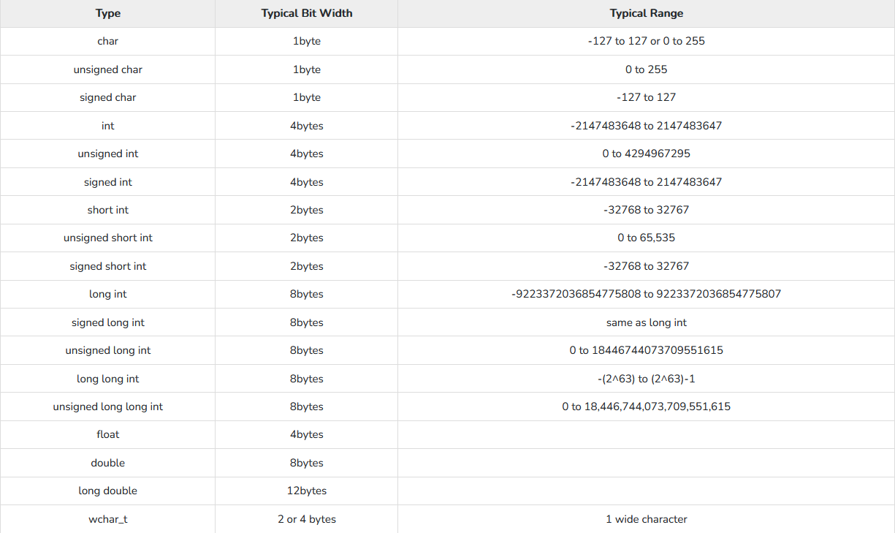
Data types and memory usage

Slide 8
Conversion between variables
Known as type-casting
Implicit conversion
Explicit conversion
Various other functions
int a = 3;
float b;
b = a;
int a = 3;
float b;
b = (float)a; // c-like casting
b = float(a); // functional conversion
int a = 11;
// the following requires the "string" header
// int to string
std::string numberString = std::to_string(a);
// string back to int
int b = std::stoi(numberString);

Slide 9
Global vs local variables
Normally variables (like most entities) are local to the block they are in and its nested blocks
Variables can be declared at the top of the file before the main() function to make them accessible anywhere in the program
Global variables
Relevant keywords:
extern
Tells the compiler that the variable exists (usually in another file)
static
The value of the variable persist through different calls of a function or instances of a class

Slide 10
References
Aliases for existing variables
Created by putting an ampersand (&) between variable type and name when creating variables
int a = 10; // creates an integer
int& b = a; // creates a reference to a
int &c = a; // also creates a reference to a
a = 20;
std::cout << "a: " << a << std::endl; // variable a prints value of a
std::cout << "b: " << b << std::endl; // reference of a prints value of a
std::cout << "c: " << c << std::endl; // reference of a prints value of a
std::cout << "&a: " << &a << std::endl; // note: pointer, not reference
a: 20
b: 20
c: 20
&a: 0000004E1515F854

Slide 11
Pointers
Variables that store memory addresses of other variables
Created by putting an asterisk (*) between variable type and name when creating variables and using the ampersand operator before a declared name
Dereference operator (also an asterisk) returns the underlying value
int a = 10;
int* b = &a;
a = 20;
std::cout << "a: " << a << std::endl; // variable a prints value of a
std::cout << "b: " << b << std::endl; // variable b (pointer) prints address of a
std::cout << "&a: " << &a << std::endl; // directly print the pointer
std::cout << "*b: " << *b << std::endl; // dereference pointer to get the value
a: 20
b: 000000E8208FF4E4
&a: 000000E8208FF4E4
*b: 20

Slide 12
References vs pointers
Once initialized to an object, references cannot be changed
Pointers can be changed to point to another object
int a = 1;
int c = 2;
int& b = a;
b = c; // not a reassignment of the reference; rather, the value of c is assigned to the object referred to by b
std::cout << "a: " << a << std::endl;
std::cout << "b: " << b << std::endl;
std::cout << "c: " << c << std::endl;
int a = 1;
int c = 2;
int* b = &a; // b is a pointer to a
std::cout << "b: " << b << std::endl;
b = &c; // change b to point to c instead of a
std::cout << "b: " << b << std::endl;
b: 000000687E7FF904
b: 000000687E7FF924
a: 2
b: 2
c: 2

Slide 13
References vs pointers
References must be initialized (given an initial value) when they are created, pointers can be initialized later
You cannot have null references (references not pointing anywhere), but you can have null pointers
Pointers point to the memory address of a variable, references to the value directly
int& a; // error
int* b; // valid
int& a = NULL; // error
int* b = NULL; // valid

Slide 14
References & pointers: Why bother?
References (and pointers) allow you to pass arguments to functions…
without copying the entire object that is passed as argument
while allowing to modify the object given as argument inside the function
while utilizing polymorphism (more in a later topic)
More about references in functions in later slides this lecture
Prefer references over pointers
Breaking your program is easier with pointers
Use pointers only when you must

Slide 15
Functions
Perform an operation or several operations
Must be declared and defined before using
Using a function is “calling” or “invoking” it
Both user-written and built-in
Parameters
Arguments
Return type

Slide 16
Declaration vs definition vs initialization
Declaration introduces a new entity to the compiler
Variable, function, type, class, whatever
“This identifier exists”
For functions, specifies signature
Name, return type and parameters
Definition allocates memory for the entity
“This identifier works like this”
For functions, defines its body
What operations the function does
Initialization assigns an initial value to entity
Variable definitions are often also declarations
Variable declaration-definitions can also be initializations
double inverse(double input);
double inverse(double input) {
return (1.0 / input);
}
int a; // declaration and definition: identifier "a" exists and is an integer
int b = 1; // declaration, definition and initialization

Slide 17
Functions: parameter vs argument
double num1 = -6;
double num2 = 2.5;
double product;
product = productFunction(num1, num2);
Argument:
Value that is passed to the function when the function is called
Parameter:
Belongs to the function signature
Defined when the function is declared
Becomes a local variable of the function
Is assigned the value of the argument
A function doesn’t need to have inputs or outputs
bool productFunction(double a, float b) {
return a*b;
}

Slide 18
Functions: return type
Many functions have a return type that is specified in function declaration
Functions without a return type are given the void “type”
The above example also has no parameters (and no arguments when it’s called)
bool isPositive(double num) {
return num > 0;
}
void sayHello() {
std::cout << "Hello" << std::endl;
}

Slide 19
Functions: pass by value and pass by reference
Pass by value
The argument is copied into the scope of the function
Can be expensive if the argument is a large object
Cannot modify values outside the function
Safer choice
Pass by reference: put an ampersand before parameter name
The function gets a reference to the object instead copying the object itself
Modifies the value of the argument even outside the function
Faster choice when arguments are large objects
The same function can have some parameters passed by value and some passed by reference

Slide 20
Functions: pass by value vs pass by reference
int plusThreeValue(int num) {
num += 3; // increment 3
return num;
}
int plusThreeReference(int& num) {
num += 3; // increment 3
return num;
}
int myNumber = 1;
int outputByValue = plusThreeValue(myNumber); // returns 4
// myNumber is still 1, because it was copied into the function
int outputByReference = plusThreeReference(myNumber); // returns 4
// myNumber is now 4, because 3 was added to myNumber instead of its copy

Slide 21
Functions: returning values by reference
Put an ampersand between function type and name
Allows functions to be used on the left side of an assignment operator
Never return a local variable outside its scope!
// an array of doubles
double globalArray[] = {1.4, 6.0, 4.2};
// function to return by reference
double& updateArray(unsigned int i) {
return globalArray[i];
}
int main()
{
// set the 3rd element to 1.0
updateArray(2) = 1.0;
}
double& returnByReferenceLocal() {
double someDouble = 23.5;
return someDouble;
}

Slide 22
Function templates
Functions that can operate with generic instead of specific types
Works with several data types or classes, but with just one definition
Return types and parameters can be templatized
Eliminates the need for many similar functions

Slide 23
Function templates: parameter
template <typename whateverType>
void printArray(whateverType inArray, unsigned int numElements) {
for (unsigned int i = 0; i < numElements; ++i) {
std::cout << inArray[i] << " ";
}
std::cout << std::endl;
}
int main()
{
int intArray[4] = {5, 70, 12, 56};
float floatArray[3] = {1.5, 50.3, -12.4};
printArray(intArray,4);
printArray(floatArray,3);
}
5 70 12 56
1.5 50.3 -12.4

Slide 24
Function templates: return type
template <typename whateverType>
whateverType additiveInverse(whateverType a) {
return -a;
}
int main()
{
int a = 2;
float b = 2.5;
double c = -2546.05;
std::cout << additiveInverse(a) << std::endl;
std::cout << additiveInverse(b) << std::endl;
std::cout << additiveInverse(c) << std::endl;
}
-2
-2.5
2546.05

Slide 25
Command-line arguments
The main function can receive arguments from the command line
int main(int argc, char *argv[])
{
for (int i = 0; i < argc; ++i)
std::cout << argv[i] << std::endl;
}
>Variables-functions.exe 1 2.3 hello
Variables-functions.exe
1
2.3
hello

Slide 26
Summary
Don’t be intimidated by all the new words
Knowing when to pass by value or reference (or pointer) and what data types to use for your variables affects performance
Limit memory usage
Process data faster
Pointers should be avoided
But understanding them is required for many further concepts in C++

